Slide 1
CST-104
Object-Oriented
Programming In C++
Fourth Edition
Robert Lafore

Slide 2
History
C programming language by Dennis Ritchie at AT&T Bell Labs
(between 1969 ~ 1973)
C++ by Bjarne Stroustrup in 1983

Slide 3
Lecture Outlines(First Semester)
Chapter - 1 The Big Picture
Chapter - 2 C++ Programming Basics
Chapter - 3 Loops and Decisions
Chapter - 7 Arrays and Strings

Slide 4
CHAPTER-1 THE BIG PICTURE

Slide 5
Programming Language
A set of symbols, codes and words used to write a program.
A precise sequence of steps to solve a particular problem.

Slide 6
Programming Languages…
Machine Language
Fortran
Assembly Language
BASIC
COBOL
C and C++
Pascal
Visual Basic
Smalltalk
Ada
Java
Programming languages are artificial languages created to tell the computer what to do.
They consist of vocabulary and a set of rules (grammar/syntax) to write programs.
Notes:
OOP
Object-oriented programming (OOP) refers to a type of computer programming (software design) in which programmers define not only the data type of a data structure, but also the types of operations (functions) that can be applied to the data structure.
Object-oriented programming (OOP) is a programming paradigm based on the concept of "objects", which may contain data, in the form of fields, often known as attributes; and code, in the form of procedures, often known as methods. A feature of objects is that an object's procedures can access and often modify the data fields of the object with which they are associated (objects have a notion of "this" or "self"). In OOP, computer programs are designed by making them out of objects that interact with one another.^{[1][2]} There is significant diversity of OOP languages, but the most popular ones are class-based, meaning that objects are instances of classes, which typically also determine their type.

Slide 7
Programming Languages Types
The Evolution
of Programming Languages

Slide 8
The steps that must be taken to transform a program written in a high-level language into an executable program.
Fig : Transformation of a high-level language into a program

Slide 9
Details of a Typical C++ Environment
Phases of C++ Programs:
Edit
Preprocess
Compile
Link
Load & Execute
Program is created in
the editor and stored
on disk.
Editor
Disk
Preprocessor
Disk
Preprocessor program
processes the code.
Compiler creates
object code and stores
it on disk.
Compiler
Disk
Linker links the object
code with the libraries,
creates a.out and
stores it on disk
Linker
Disk
Primary
Memory
Loader
Loader puts program
in memory.
Disk
.
.
.
.
.
.
Primary
Memory
CPU
CPU takes each
instruction and
executes it, possibly
storing new data
values as the program
executes.
.
.
.
.
.
.

Slide 10
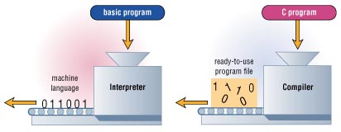
Compilers and Interpreters
An interpreter translates source code one line at a time and executes the instruction. Eg. BASIC
A compiler is a program that changes source code to object code, all in one shot. Eg. C++
Notes:
Compiler : Compilers are used to convert high level languages (like C, C++ ) into machine code .
Example : gcc , Microsoft Visual Studio
Assembers : Assembler are used to convert assembly language code into machine code.
Interpreter : An interpreter is a computer program which executes a statement directly (at runtime).
Examples: python , LISP, Ocamle

Slide 11
Structured Design
Structured programming implements structured design
Use three fundamental control structures :Sequence, Selection, Repetition
Sequence control structure – Instructions are executed in the order in which they appear
Selection control structures – The program branches to different instructions depending on whether a condition is met; IF…THEN…ELSE
Repetition control structure – The program repeats the same instructions over and over; DO-WHILE and DO-UNTIL

Slide 12
What Can a Procedural Program Do?
A linear, procedural program is structured to instruct a computer to:
Read Input
Calculate
Store data
Write Output

Slide 13
Problems with Structural Programming
Unrestricted access to global data
The problem with the procedural paradigm is that this leads to an even larger number of potential connections between functions and data
Unrelated functions and data provide a poor model of the real world

Slide 14
Compiling / Building
(.cpp file) source code
compiler
(.h files)
(.obj file)
object code
linked to libraries
object code from other source files
executable file

Slide 15
Some Important Terms
A source program (.cpp file type) consists of the program statements comprising a C++ or other programming language program.
An object program (.obj file type) is the result of compiling a source program.
Header files (.h file type) contain constant, variable, and function declarations needed by a program.
An executable program is a program that can be run by a computer.
Linking adds code from libraries to your file. Collects the object code from all files in the workspace and puts them into one executable program.

Slide 16
CHAPTER-2 C++ PROGRAMMING BASICS

Slide 17
General Structure of a C++ Program
Preprocessor Directive
Header File
#include
< iostream.h >
Return Type
main Function
void main()
{
statement 1;
statement 2;
…
statement n;
}
Body of main Function

Slide 18
General Structure of a C++ Program
Preprocessor Directive
Header File
#include
< iostream.h >
Return Value Type
Function Name
Argument List
int main ()
{
statement 1;
statement 2;
…
statement n;
return 0;
}
Body of main Function
Return value 0
Normal terminate
program

Slide 19
What does the code mean?
#include <iostream.h>
Processed by the pre-processor (it’s called a pre-processor directive).
A preprocessor directive is an instruction to the compiler.
#include directive tells the compiler to insert another file into your source file.
iostream.h – an example of Header files (sometimes called an include file).
Literally copies and pastes the libraries of functions.

Slide 20
What does the code mean?
main()
Remember, every C++ program is made of one or more functions
A function is a piece of code that accomplishes one specific task
Every executable C++ program has one function called main()
This is where execution (the actual running) of the program (i.e., the computer instructions) starts…
Each statement ends with a semi-colon “;”

Slide 21
Output Statement in C++(cout)
cout << “Message” ;
cout is a reserved word.
The header file which is to be included for cout is <iostream.h >
The operator << is called the insertion or put to operator.
Causes the phrase in quotation marks to be displayed on the screen

Slide 22
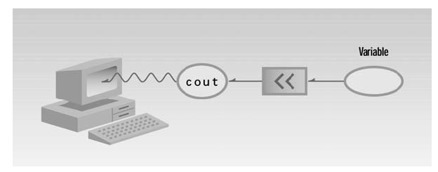
Output with cout

Slide 23
// My First Program
# include <iostream.h>
void main () {
cout << “Welcome to UIT”;
}

Slide 24
What does the code mean?
cout << “Welcome to UIT”;
This line tells the computer to print something to the screen
If you want to print something to the screen you use the cout function
Every line in c++ ends with a semi-colon “ ; ” (Statement Terminator).

Slide 25
Error, error… does not compute!
Syntax refers to the structure of a program and the rules about that structure
Syntax Errors – Typing Errors
Errors in spelling and grammar (syntax).
“Doag. Bites, Man”
You can use the compiler or interpreter to uncover syntax errors.
You must have a good working knowledge of error messages to discover the cause of the error.
Semantic Errors – Logic or Meaning Errors
Errors that indicate the logic used when coding the program failed to solve the problem.
“Man bites dog.”
You do not get error messages with logic errors.
Your only clue to the existence of logic errors is the production of wrong solutions.
Run-time Errors (Exceptions)
Code does something illegal when it is run (hence runtime)
E.g., divide by zero

Slide 26
Comments in C++
is used to explain to the person looking at the listing what you are trying to do
The compiler ignores comments
Comment Syntax
Single line comment
Starts with a double slash symbol (//). For example- // It is a comment
Multi-line comment
Begins with the /* character pair and ends with */ For example-
/* This is a very long
multi line
comments */

Slide 27
Variable
is a symbolic name
can be given a variety of values
is a memory location whose contents can be changed.
is used to stores some data in a C++ program

Slide 28
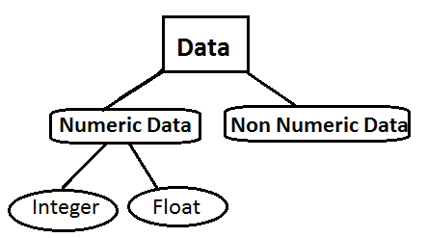
Data Types
Generally, two broad categories of Data

Slide 29
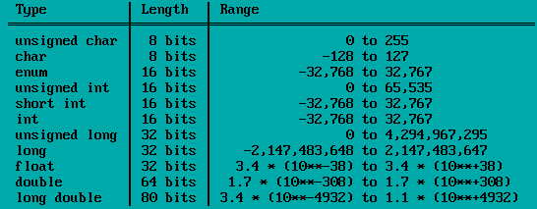
Basic Data Types
In MS Turbo C++,

Slide 30
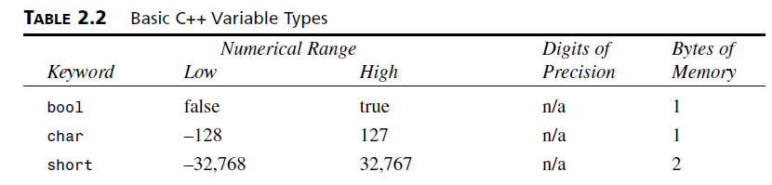
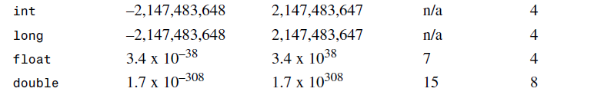
Basic C++ Data Types

Slide 31
Identifier Names (Variable Names)
Variable, Functions, Structures, Classes and etc.
Rules
May be any length
Are case sensitive
Must begin with a letter, which includes an underscore(_)
Subsequent characters may be letters, digits and underscores
Cannot be a keyword
May only be defined once in a scope
Should avoid library names
Must be declared before use
Must be defined exactly once

Slide 32
Reserved Words or Keyword
A keyword is a predefined word with a special meaning.
Cannot be used these words as a variable name.
Each Reserved word has its specific purpose.
For example, include, main, cout etc.

Slide 33
Key Words Table

Slide 34
Integer Data Type
A data type which contains only whole numbers. Whole numbers means, numbers having no decimal point. For example 123,465, -25 etc
When we declare an integer variable, compiler reserves two bytes in memory(System Dependent)
In MS-DOS integer occupies 2bytes,on 32 bit System integer occupies 4 bytes memory.
int variablename;
for example int a;

Slide 35
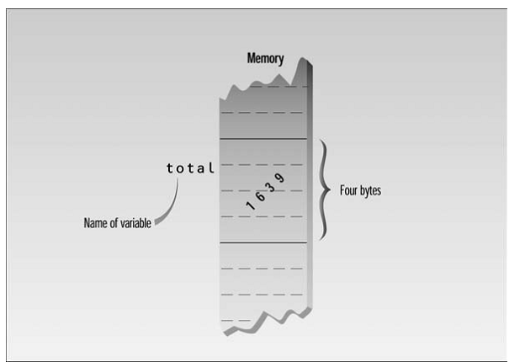
Variable of type int in memory

Slide 36
Declaration / Assignment Statement
A Declaration introduces a variable’s name (var1) into a program and specifies its type ( such as int, float, char).
e.g. int var1; int var1, var2;
Assignment statement assigns values to variable.
For example, int var1=10;
Equal Sign ‘=‘ assigns the value on the right hand to the variable on the left hand side.

Slide 37
Example Program
//intvars.cpp
//demonstrates int variables
#include<iostream.h>
void main()
{
int var1, var2; //define var 1; define var2; also call identifers;
var1=20; // assing 20 to var1;
var2= var1 + 10; // assingn value to var2;
// endl is linefeed to be inserted into the stream; same as “\n” character
cout << “var1 + 10 is ” ; // output text;
cout<< var2<<endl; // output value;
}

Slide 38
Other Integer Types
Long - 4 bytes (long int = long)
- especially used for system 64 or MS-DOS
Short – 2 bytes
- Both have fixed sizes no matter what system is used.

Slide 39
Char Data Type
Char data type used to store, input and output a single character in our program.
Type char stores integers that range in value from -128 to 127.
To store ASCII character (eg ‘a’, ‘b’,’c’,’3’,’$’)
Character data type uses single quotation marks around a character. It differs from string constants, which uses double quotation marks.
It occupies only one byte (= 8 bits) in memory.
char variablename; e.g., char c;
For example char ch = ‘a’;

Slide 40
Character and String constant
Character constant => ‘b’
String constant => “Hello”
When compiler encounters such a character constant ( ‘a ’), translate into corresponding ASCII code (‘a’ => 97)

Slide 41
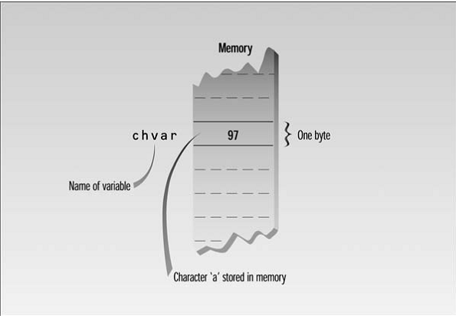
Variable of type char in memory

Slide 42
Example Program
//charvars.cpp
//demonstrates character variables
#include<iostream.h>
void main()
{
char charvar1='A'; //define char variable as character
char charvar2='\t';//define char variable as tab
cout<<charvar1; //display character
cout<<charvar2; //display character
charvar1='B'; //set char variable to char constant
cout<<charvar1; //display character
cout<<'\n'; //display newline character
}

Slide 43
Escape Sequence Characters
Escape Sequence | Character
\a | Alert (i.e., bell)
\b | Backspace
\f | Form feed
\n | New line
\r | Carriage return
\t | Horizontal tab
\\ | Backslash
\’ | Single quote
\” | Double quote
\xdd | Hexadecimal number

Slide 44
// Program for using Escape Sequence
#include<iostream.h>
void main()
{
cout<<"\"Run, Spot, run,\" she said.";
}

Slide 45
Input Statement in C++(cin)
int var1=10; in this example, the value of variable is assigned within the program which is making the program to restrict to this value only.
We have a function called “cin” function which provides opportunity to make more generalize program.
It provides an option to the users to enter the values at run time from the keyboard.
cin>>variablename; For example , cin>>var1;

Slide 46
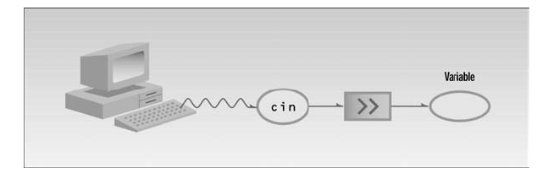
Input with cin

Slide 47
Program for adding two numbers
#include<iostream.h>
#include< conio.h>
void main()
{
clrscr(); //to clear screen
int a,b,c;
cout<<“Enter Value for a ”;
cin>>a;
cout<<“Enter Value for b ”;
cin>>b;
c = a + b;
cout << “ Sum = ” << c;
getch(); //get a character from console, doesn’t echo to the screen
}

Slide 48
Program for converting Fahrenheit to Celsius
//fahren.cpp
//demonstrates cin, newline
#include<iostream.h>
#include< conio.h>
void main()
{
clrscr(); //to clear screen
int ftemp; //for temperature in fahrenheit
cout<<"Enter temperature in faherenheit: ";
cin>>ftemp;
int ctemp=(ftemp-32) * 5/9;
cout<<"Equivalent in Celsius is: "<<ctemp<<'\n';
getch(); //get a character from console, doesn’t echo to the screen
}

Slide 49
Expression and Statements
Expressions produce a value
Constant
Variable
Function call (returning a value – not void)
Grouping of the above combined with operators
For example: 10, var1, var1+10, sqrt(var1), var1>10
Statements form a complete unit of work (called instructions)
Are terminated with a semicolon (;)
May span lines or may be more than one on a line
Simple statements. For example : sum = var1 + var2;
Compound (or block) statements are formed of simple statements between { and }. Block is not terminated with a semicolon. For example:
{
var1 = 10; var2 = var1 * 2;
sum = var1 + var2;
cout<<“Sum = ”<<sum;
}

Slide 50
Float Data Type
Float are the numbers having decimal point in it.
A floating point has two parts. An integer portion and fractional portion also called mantissa.
For example 24.60, 29.55 etc.
When we declare a float variable, compiler reserves four consecutive bytes in memory.
occupies 4 bytes (32 bits) in memory
float variablename;
For example , float b;

Slide 51
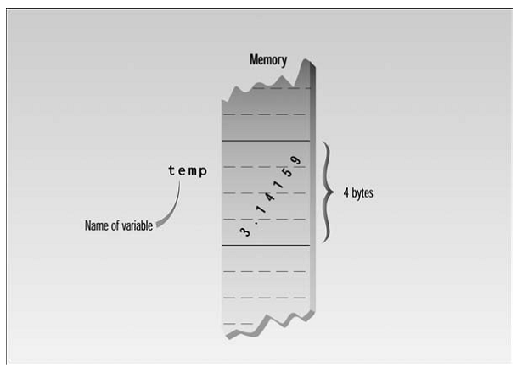
Variable of type float in memory

Slide 52
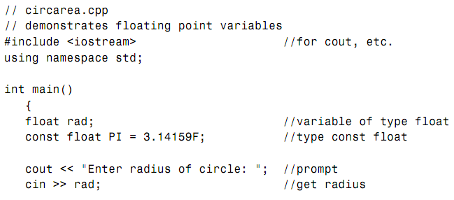
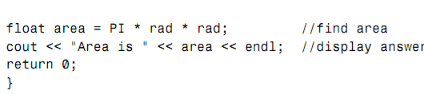
Calculate and display circle’s area

Slide 53
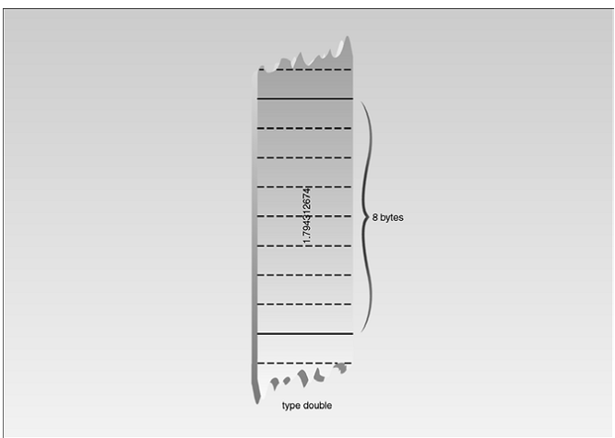
Double and Long Double
Larger floating point type
Double => Require 8 bytes
Long Double(= Double) =>compiler dependent

Slide 54
Floating Point Constant
const float PI= 3.14159F
3.14159 => floating point constant
F => float type
The value of PI will not change throughout the program
Any attempt to alter , error message from compiler
floating-point constants using exponential notation
1,000,000,000 => 1.0E9
1234.56 =>1.23456E3
0.0000635239=>6.35239E–5

Slide 55
# define Directive
Constant can also be specified using the preprocessor directive # define.
# define PI 3.14159
Appear at the beginning of program

Slide 56
const and #define
const Qualifier
Keyword const (for constant) precedes the data type of a variable
The value of a variable will not change throughout the program
For example:
const float PI=3.14159F;
#define Directive
Constants can also be specified using the preprocessor directive #define
Can’t specify the data type of the constant using #define
For example:
#define PI 3.14159

Slide 57
Type bool
int => billions of possible value
char => 256
bool => only two possible values : true and false
Requires only one bit of storage.
In practice , compilers store them as bytes because quickly accessed.

Slide 58
setw Manipulator
setw is used the field width of output. If you used the setw, declare the header file of iomanip.
//width1.cpp
//demonstrates need for setw manipulator
#include<iostream.h>
#include< conio.h>
void main()
{
clrscr();
long pop1=2425785, pop2=47, pop3=9761;
cout<<"LOCATION "<<"POP."<<endl
<<"Portcity "<<pop1<<endl
<<"Hightown "<<pop2<<endl
<<"Lowville "<<pop3<<endl;
getch();
}

Slide 59
Example for setw manipulator
//width2.cpp
//demonstrates setw manipulator
#include<iostream.h>
#include< conio.h>
#include<iomanip.h>
void main()
{
clrscr();
long pop1=2425785, pop2=47, pop3=9761;
cout<<setw(8)<<"LOCATION "<<setw(12)<<"POP."<<endl
<<setw(8)<<"Portcity "<<setw(12)<<pop1<<endl
<<setw(8)<<"Hightown "<<setw(12)<<pop2<<endl
<<setw(8)<<"Lowville "<<setw(12)<<pop3<<endl;
getch();
}

Slide 60
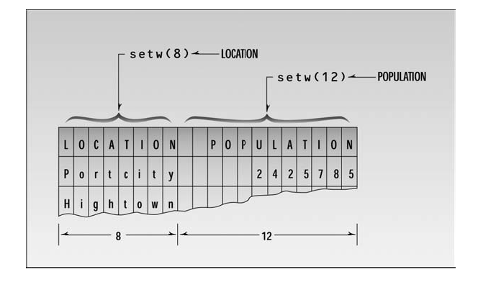
Field width and setw

Slide 61
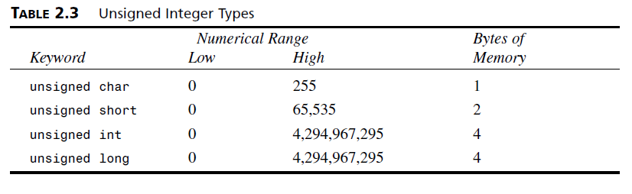
Unsigned Data Types

Slide 62
signed and unsigned
//signtest.cpp
// tests signed and unsigned integers
#include<iostream.h>
#include< conio.h>
void main()
{ clrscr();
int signedVar=20000; //signed
unsigned int unsignVar=20000; //unsigned
signedVar = (signedVar*2)/3; //calculation exceeds range
unsignVar = (unsignVar *2)/3;//calculation within range
cout<<"signedVar = "<<signedVar<<endl; //wrong
cout<<"unsignVar = "<<unsignVar<<endl; //ok
getch();
}

Slide 63
Type Conversion
//mixed.cpp
//showed mixed expressions
#include<iostream.h>
#include< conio.h>
void main()
{ clrscr();
int count=7;
float avgWeight=155.5F;
double totalWeight=count*avgWeight;
cout<<"totalWeight="<<totalWeight<<endl;
getch();
}

Slide 64
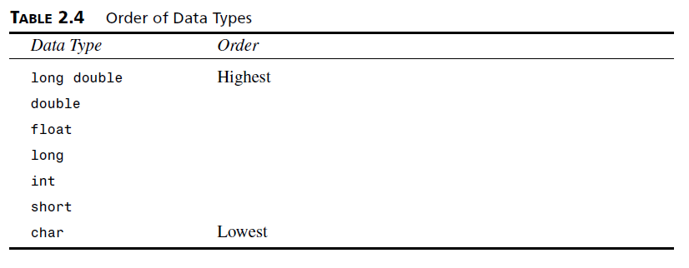
Automatic Conversions

Slide 65
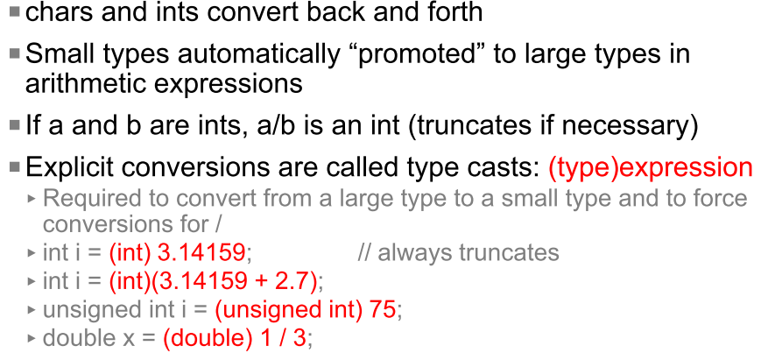
Data Type Conversions

Slide 66
Casts (Type Casts)
//cast.cpp
//tests signed and unsigned integers
#include<iostream.h>
#include< conio.h>
void main()
{ clrscr();
int intVar = 20000; //20,000
intVar=(intVar*10)/10; //result too long
cout<<"intVar = "<<intVar<<endl; //wrong answer
intVar=20000;
intVar=((double)(intVar)*10)/10; //cast to double
cout<<"intVar = "<<intVar<<endl; //right answer
getch();
}

Slide 67
Operators in C++ Language
An operator is a symbol that cause the compiler to take an action.
There are following types of operators.
Arithmetic Operators
Unary Operators
Relational Operators
Logical Operators
Conditional Operators
Assignment Operators

Slide 68
Arithmetic Operators
Arithmetic operator used to perform arithmetic operations.
Operator | Purpose | Example
+ | Performs Addition | a=2; b=3; c=a+b; c=5;
- | Performs Subtraction | a=5; b=3; c=a-b; c=2;
* | Performs Multiplication | a=2; b=3; c=a*b; c=6;
/ | Gives Quotient after Division | a=10; b=2; c=a/b; c=5;
% | Gives Remainder after Division | a=10; b=3; c=a%b; c=1

Slide 69
Operators Precedence
Orders | Operators | Evaluation
1st | ( ) Parenthesis | Left to Right
2nd | * , / , % | Left to Right
3rd | + , - | Left to Right

Slide 70
Remainder Operator(%) or modulus operator
//remaind.cpp
// demonstrates remainder operator
#include<iostream.h>
#include< conio.h>
void main()
{ clrscr();
cout<<6%8<<endl //6
<<7%8<<endl //7
<<8%8<<endl //0
<<9%8<<endl //1
<<10%8<<endl; //2
getch();
}

Slide 71
Compound Assignment Operators
Operator | Purpose | Example
= | Assigns the given value to variable | i=10; then value will become 10.
+= | Increment the value of the variable by the given value | If i = 10, then i + = 2 value of i= 12;
-= | Decrease the value of the variable by the given value | If i = 10, then i - = 2 value of i= 8;
*= | Multiply the value of the variable by the given value | If i = 10, then i * = 2 value of i= 20;
/= | Divides the value of the variable by the given value | If i = 10, then i / = 2 value of i= 5;
%= | Divides the value of the variable by the given value and assigns the remainder | If i = 11, then i % = 2 value of i= 1;

Slide 72
Arithmetic Assignment Operator
//assign.cpp
//demonstrates arithmetic assignment operators
#include<iostream.h>
void main()
{ int ans=27;
ans+=10; //same as: ans = ans + 10;
cout<<ans<<", ";
ans-=7; //same as: ans = ans - 7;
cout<<ans<<", ";
ans*=2; //same as: ans = ans * 2;
cout<<ans<<", ";
ans/=3; //same as: ans = ans / 3;
cout<<ans<<", ";
ans%=3; //same as: ans = ans % 3;
cout<<ans<<endl;
}

Slide 73
Unary Operator
Increment Operator
You often need to add 1 to the value of an existing variable.
count = count + 1;
Or you can use an arithmetic assignment operator:
count += 1;
But there’s an even more condensed approach:
++count;
count++;
The ++ operator increments (adds 1 to) its argument.

Slide 74
Prefix and Postfix
The increment operator can be used in two ways:
As a prefix, meaning that the operator precedes the variable(eg .++count).
As a postfix, meaning that the operator follows the variable(eg. count++).
Example
int count=2;
int avgWeight=4;
totalWeight = avgWeight * ++count;
totalWeight = avgWeight * count++;

Slide 75
Example for Increment Operator
//increm.cpp
// demonstrates the increment operator
#include<iostream.h>
#include< conio.h>
void main()
{ clrscr();
int count=10;
cout<<"count="<<count<<endl; //displays 10
cout<<"count="<<++count<<endl; //displays 11 (prefix)
cout<<"count="<<count<<endl; //displays 11
cout<<"count="<<count++<<endl; //displays 11 (postfix)
cout<<"count="<<count<<endl; //displays 12
getch();
}

Slide 76
Decrement Operator
Decrement operator (--)
behaves very much like the increment operator
subtracts 1 from its operand
can be used in both prefix and postfix forms

Slide 77
Example for Decrement Operator(--)
// decrem.cpp
// demonstrates the increment operator
#include <iostream.h>
int main()
{
int count = 10;
cout << “count=” << count << endl; //displays 10
cout << “count=” << --count << endl; //displays 9
cout << “count=” << count << endl; //displays 9
cout << “count=” << count-- << endl; //displays 9
cout << “count=” << count << endl; //displays 8
return 0;
}

Slide 78
Library Functions
//sqrt.cpp
// demonstrates sqrt() library function
#include<iostream.h>
#include< conio.h>
#include<math.h>
void main()
{ clrscr();
double number, answer; //sqrt() requires type double
cout<<"Enter a number: ";
cin>>number; //get the number
answer=sqrt(number); //find square root
cout<<"Square root is "<<answer<<endl; //display it
getch();
}

Slide 79
Example program
#include<iostream.h>
int main()
{
char ascii;
int numeric;
cout<< “Give character: ”;
cin>>ascii;
cout<<“Its ascii value is: ” <<(int) ascii <<endl;
cout<<“Given a number to convert to ascii: ”;
cin>>numeric;
cout<<“The ascii value of ”<<numeric<< “is” <<(char) numeric;
return 0;
}

Slide 80

Lets Do Exercises!!!

Slide 81
Chapter 3 – Loops and Decisions

Slide 82
Control Statements
Program statements that cause such jumps are called control statements
Two major categories:
Loops
Decisions
How many times a loop is executed, or whether a decision results in the execution of a section of code, depends on whether certain expressions are true or false.
These expressions typically involve a kind of operator called a relational operator, which compares two values.

Slide 83
Relational Operators
A Relational expressions is the expression whose result can either be true or false.
Operator | Purpose
> | Compare two variables whether the 1st variable is greater or not
< | Compare two variables whether the 1st variable is smaller or not
>= | Compare two variables whether the 1st variable is greater or equal to2nd variable
<= | Compare two variables whether the 1st variable smaller or equal to 2nd variable
== | Compare two values for equality
!= | Compare for the non-equalities of the given values.

Slide 84
Example of Relational Operators
relat.cpp
#include <iostream.h>
#include <conio.h>
void main()
{
clrscr();
int numb;
cout << “Enter a number: “;
cin >> numb;
cout << “numb<10 is “ << (numb < 10) << endl;
cout << “numb>10 is “ << (numb > 10) << endl;
cout << “numb==10 is “ << (numb == 10) << endl;
getch();
}

Slide 85
Logical Operators
Logical operators are used to combine two or more relational expressions.
Operator | Name | Example
&& | AND | If one of the expression is false then the result of && operator will be false. If (x>2) && (x<5)
| | | OR | If (x>2) || (y>2) then the result of this expression will be true if either of the value of x and y is greater 2. If both conditions are false then the result will be false.
! | NOT | This Operator is used for negation purpose

Slide 86
Decision / Selection Statements
A decision causes a one-time jump to a different part of the program, depending on the value of an expression
Decisions can be made in C++ in several ways.
Simple if statement
if...else statement, which chooses between two alternatives
Switch statement, which creates branches for multiple alternative sections of code
the conditional operator is used in specialized situations

Slide 87
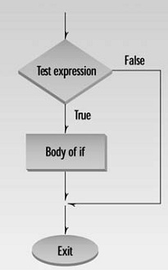
Simple if Statement
if statement: Implements a decision structure for two alternatives
Syntax:
if (condition)
statement; //executed if condition is true;
(or)
if (condition)
{
statement 1;
statement 2;
…
statement n;
}
no semicolon here

Slide 88
Simple if Statement
ifdemo.cpp
#include<iostream.h>
#include<conio.h>
void main()
{
clrscr();
int x;
cout<<"Enter a number: ";
cin>>x;
if(x>100)
cout<<"That number is greater than 100\n";
getch();
}

Slide 89
Multiple Statements in the if Body
if2.cpp
//demonstrates if with multiline body
#include<iostream.h>
#include<conio.h>
void main()
{
clrscr();
int x;
cout<<"Enter a number: ";
cin>>x;
if(x>100)
{
cout<<"The number "<<x;
cout<<" is greater than 100\n";
}
getch();
}

Slide 90
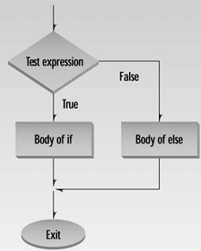
The if-else Statement
if-else statement: Implements a decision structure for two alternatives
Syntax:
if (condition)
statement; //executed if condition is true;
else
statement; //executed if condition is false;
(or)
if (condition)
{
statement 1;… statement n;
}
else
{
statement 1;… statement n;
}
no semicolon here
no semicolon here

Slide 91
The if-else Statement (Example)
ifelse.cpp
//demonstrates if…else statement
#include<iostream.h>
#include<conio.h>
void main()
{
clrscr();
int x;
cout<<"Enter a number: ";
cin>>x;
if(x > 100)
cout<<"That number is greater than 100\n";
else
cout<<"That number is not greater than 100\n";
getch();
}

Slide 92
The if-else Statement (Example)
else_exam.cpp
//demonstrates if…else statement
#include<iostream.h>
#include<conio.h>
void main()
{
clrscr();
int mark;
cout<<"Enter an exam mark: ";
cin>>mark;
if(mark > =50)
cout<<“Pass the exam\n";
else
cout<<“Fail the exam \n";
getch();
}

Slide 93
The if-else Statement (continued)
ifelse2.cpp
#include <iostream.h>
#include <math.h>
int main()
{
double radius;
cout<<"Please type in the radius:";
cin >> radius;
if (radius < 0.0)
cout << "A negative radius is invalid" << endl;
else
cout<< " The area of this circle is" << 3.1416 * pow(radius,2) <<endl;
return 0;
}

Slide 94
Problems Associated with if-else Statement
Common problems with if-else statements:
Misunderstanding what an expression is
Using the assignment operator (=) instead of the relational operator (==)

Slide 95
The if-else Statement (continued)
else_same.cpp
//demonstrates if…else statement
#include<iostream.h>
#include<conio.h>
void main()
{
clrscr();
int first, second;
cout<<"Enter a first number: ";
cin>>first;
cout<<"Enter a second number: ";
cin>>second;
if(first==second)
cout<<“The two numbers are same\n";
else
cout<<“The two numbers are different\n";
getch();
}

Slide 96
The if-else Statement (Example)
pos_neg.cpp
//demonstrates if…else statement
#include<iostream.h>
#include<conio.h>
void main()
{
clrscr();
int x;
cout<<"Enter a number: ";
cin>>x;
if(x > =0)
cout<<“Positive number\n";
else
cout<<“Negative number\n";
getch();
}

Slide 97
Nested if Statements
if-else statement can contain any valid C++ statement, including another if-else (ifs inside ifs)
Nested if statement: an if-else statement completely contained within another if-else
Use braces to block code, especially when inner if statement does not have its own else

Slide 98
The if-else Statement (Example)
pos_neg.cpp
#include<iostream.h>
#include<conio.h>
void main()
{
clrscr();
int x;
cout<<"Enter a number: ";
cin>>x;
if(x >=0)
{
if(x==0)
cout<<“That number is zero\n";
else
cout<<“That number is positive number\n”;
}
else
cout<<“That number is negative number\n";
getch();
}

Slide 99
Nested if Statements
result.cpp
#include<iostream.h>
#include<conio.h>
void main()
{ clrscr();
int mark1,mark2,mark3;
cout<<"Enter three marks: ";
cin>>mark1>>mark2>>mark3;
if (mark1 >= 50)
{
if (mark2 >= 50)
{
if (mark3 >= 50) cout<<“Pass”;
else cout<<“Fail”;
}
else cout<<“Fail”;
}
else cout<<“Fail";
getch();
}

Slide 100
The if-else Chain
if-else chain: A nested if statement occurring in the else clause of the outer if-else
If any condition is true, the corresponding statement is executed and the chain terminates
Final else is only executed if no conditions were true
Serves as a catch-all case
if-else chain provides one selection from many possible alternatives

Slide 101
The if-else Chain (continued)
Syntax
if (condition_1)
statement_1; //executed if condition_1 is true;
else if (condition_2)
statement_2; //executed if condition_2 is true;
else if (condition_3)
statement_3; //executed if condition_3 is true;
.
.
else if (condition_n)
statement_n; //executed if condition_n is true;
else
last_statement; //executed
//if the above conditions are false

Slide 102
elseif1.cpp
#include<iostream.h>
void main ()
{
int a;
cout<<"Enter a number";
cin>>a;
if( a == 10 )
{
cout << "Value of a is 10" << endl; // if condition is true then print the following
}
else
{
if( a == 20 ) cout << "Value of a is 20" << endl; // if else if condition is true
else
{
if( a == 30 ) cout << "Value of a is 30" << endl; // if else if condition is true
else
cout << "Value of a is not matching" << endl; // if none of the conditions is true
}
}
}

Slide 103
else if Example
elseif2.cpp
#include<iostream.h>
void main ()
{
cout<<“Enter a number”;
cin>>a;
if( a == 10 )
cout << "Value of a is 10" << endl; // if condition is true then print the following
else if( a == 20 ) cout << "Value of a is 20" << endl; // if else if condition is true
else if( a == 30 ) cout << "Value of a is 30" << endl; // if else if condition is true
else cout << "Value of a is not matching" << endl; // if none of the conditions is true
}

Slide 104
if-else Example
examresult.cpp
#include<iostream.h>
#include<conio.h>
void main()
{ clrscr();
int mark1,mark2,mark3;
cout<<"Enter three marks: "; cin>>mark1>>mark2>>mark3;
if (mark1 >= 50 && mark2 >=50 && mark3 >= 50)
{
if (mark1 >= 80 && mark2 >=80 && mark3 >= 80)
cout<<“Pass with Distinction”;
else if(mark1 >= 65 && mark2 >=65 && mark3 >= 65)
cout<<“Pass with Credit”;
else cout<<“Pass”;
}
else cout<<“Fail";
getch();
}

Slide 105
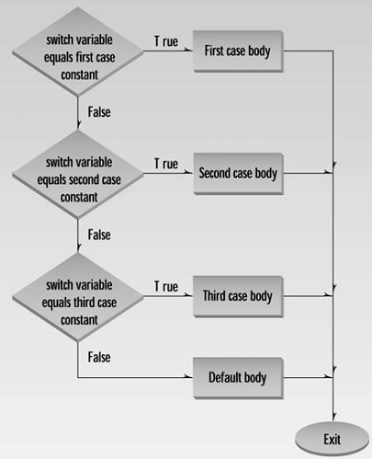
switch Statement
If all the decisions depend on the same variable, consider switch statement instead of if…else or else if constructions
Syntax
switch (integer or char variable)
{
case 1:
statement; … statement;
break;
case 2:
statement;
break;
...
default:
statement; … statement;
}
no semicolon here
no semicolon here

Slide 106
switch Statement Example
switch1.cpp
//demonstrates switch statements
#include<iostream.h>
#include<conio.h>
void main()
{ clrscr(); int age;
cout<<"\nEnter 16, 28, or 68: “; cin>>age;
switch(age)
{
case 16:
cout<<“Teenager\n";break;
case 28:
cout<<“Young adult\n";break;
case 68:
cout<<“Old age\n";break;
default: cout<<“invalid input”;
}
getch();
}

Slide 107
switch Statement Example
switch2.cpp
//demonstrates switch statements
#include<iostream.h>
#include<conio.h>
void main()
{ clrscr();
char ch;
cout<<"\nEnter CD, VCD or DVD(c,v,d): “;
cin>>ch;
switch(ch)
{ case ‘c’:
cout<<“CD \n";break;
case ‘v’:
cout<<“VCD\n";break;
case ‘d’:
cout<<“DVD\n";break;
default: cout<<“The input is wrong”;
}
getch();
}

Slide 108
#include <iostream.h>
#include <conio.h> //for getche()
int main()
{ char dir;
int y=10; int x=20;
cout << “\nEnter direction (n, s, e, w): “;
dir = getche(); //get character
switch(dir) //switch on it
{
case ‘n’: y++; break; //go north
case ‘s’: y--; break; //go south
case ‘e’: x++; break; //go east
case ‘w’: x--; break; //go west
case ‘\r’: cout << “Exiting\n”; break; //Enter key
default: cout << “Try again\n”; //unknown char
} //end switch
return 0;
} //end main

Slide 109
Logical and (&&) Operator
#include<iostream.h>
#include<conio.h>
void main()
{
clrscr();
int mark1,mark2,mark3;
cout<<"Enter three marks: ";
cin>>mark1>>mark2>>mark3;
if (mark1 >= 50 && mark2 >=50 && mark3 >= 50)
cout<<“Pass”;
else
cout<<“Fail";
getch();
}

Slide 110
Logical or (||) Operator
#include<iostream.h>
#include<conio.h>
void main()
{
clrscr();
char ch;
cout<<"Enter a vowel: ";
cin>>ch;
if (ch==‘a’ || ch==‘e’ || ch==‘i’ || ch==‘o’ || ch==‘u’)
cout<<“vowel”;
else
cout<<“not vowel";
getch();
}

Slide 111
Logical or (!) Operator
#include<iostream.h>
#include<conio.h>
void main()
{
clrscr();
char ch;
cout<<"Enter a vowel: ";
cin>>ch;
if (!(ch==‘a’ || ch==‘e’ || ch==‘i’ || ch==‘o’ || ch==‘u’))
cout<<“ not vowel”;
else
cout<<“vowel";
getch();
}

Slide 112
Loops / Iterations
A section of the program to be repeated a certain number of times
Three kinds of loops in C++
for loop
while loop
do … while loop

Slide 113
The for loop
Executes a section of code a fixed number of times
Is used when you know, before entering the loop, how many times you want to execute the code
Syntax:
for(initialization;test/condition;increment/decrement)
statement;
(or)
for(initialization;test/condition;increment/decrement)
{
statement 1;… statement n;
}
no semicolon here
no semicolon here

Slide 114
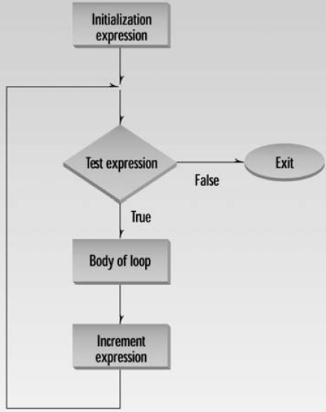
How for loop works!
initialization expression - Generally it is an initial value setting for a counter variable. This is executed only once.
test/condition expression - If the condition is true, the loop continues, otherwise the loop ends and statement is skipped (not executed).
statement – It is executed. As usual, it can be either a single statement or a block enclosed in braces { }.
whatever is specified in the increase/decrease field is executed and the loop gets back to step 2.

Slide 115
For Loop Example
// fordemo.cpp
// demonstrates simple for loop
#include<iostream.h>
#include<conio.h>
void main()
{
clrscr();
int j;
for(j=0;j<5;j++)
cout<<“Hello World!\n”;
getch();
}
Hello World!
Hello World!
Hello World!
Hello World!
Hello World!

Slide 116
for Loop Example pg.78
// fordemo.cpp
// demonstrates simple for loop
#include<iostream.h>
#include<conio.h>
void main()
{
clrscr();
int j;
for(j=0;j<15;j++)
cout<<j * j<<" ";
cout<<endl;
getch();
}
Program Output:
0 1 4 9 16 25 36 49 64 81 100 121 144 169 196

Slide 117
Multiple statements in loop body
//page 81
// cubelist.cpp
// lists cubes from 1 to 100
#include<iostream.h>
#include<conio.h>
#include<iomanip.h>
void main()
{
clrscr();
int numb;
for(numb=1;numb<=10;numb++)
{
cout<<setw(4)<<numb;
int cube = numb * numb * numb;
cout<<setw(6)<<cube<<endl;
}
getch();
}

Slide 118
for Loop Example - Page 84
// factor.cpp
// calculates factorials, demonstrates for loop
#include<iostream.h>
#include<conio.h>
void main()
{
unsigned int numb;
unsigned long fact=1;
cout<<"Enter a number";
cin>>numb;
for(int j=numb;j>0;j--)
fact *= j;
cout<<"Factorial is "<<fact<<endl;
getch();
}
Exercise: Modify Program Output
If numb is 5, display it as follows:
5!=5*4*3*2*1=120

Slide 119
Exercises
Exercise: Modify Program Output
If numb is 5, display it as follows:
5!=1*2*3*4*5=120

Slide 120
Multiple Initialization and Test Expression
#include<iostream.h>
#include<conio.h>
void main()
{
clrscr();
int j,alpha,beta=10;
for(j=0,alpha=100;j<10;j++,beta--,cout<<alpha+j<<endl);
/*
for(j=0,alpha=100;j<10;j++,beta--)
{
cout<<alpha+j<<endl;
}
*/
getch();
}

Slide 121
for Loop with a test expression of true
#include<iostream.h>
#include<conio.h>
void main()
{
clrscr();
int j=0;
for (;;) //same as a while loop
{
j++;
cout<<"j = "<<j<<endl;
if (j>=10) break;
}
cout<<"after break j = "<<j;
getch();
}

Slide 122
Nested for Loop
Nestfor.cpp
#include<iostream.h>
#include<conio.h>
void main()
{
clrscr();
int i,j;
for(i=0;i<5;i++)
{
for(j=0;j<3;j++)
cout<<“*”;
cout<<endl;
}
getch();
}
***
***
***
***
***

Slide 123
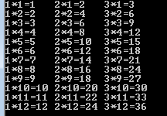
Nested for Loop
Nestfor1.cpp
#include<iostream.h>
#include<conio.h>
void main()
{
clrscr();
int i,j,k;
for(i=1;i<=12;i++)
{
for(j=1;j<=3;j++)
{
k=j*i;
cout<<j<<“*”<<i<<“=“<<k<<“\t”;
}
cout<<endl;
}
getch();
}

Slide 124
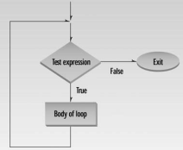
The while loop
If you don’t know how many times
If text_expression is true, the while loop execution continues
The text_expression is evaluated at the beginning of the loop
Syntax:
while(test_expression)
statement;
(or)
while(test_expression)
{
statement 1;
…
statement n;
}
no semicolon here
no semicolon here

Slide 125
while Loop Example – Page 86
//endon0.cpp
//demonstrates while loop
#include<iostream.h>
#include<conio.h>
void main()
{
clrscr();
int n; //make sure n isn’t initialized to 0
cout<<"Enter a number - Type '0' to quit";
cin>>n;
while(n!=0) //loop until n is 0
{
cout<<“Enter a number”;
cin>>n; //read a number into n
}
cout<<endl;
getch();
}

Slide 126

Multiple Statements in while Loop
//while4.cpp
//prints numbers raised to fourth power
#include<iostream.h>
#include<conio.h>
#include<iomanip.h>
void main()
{ clrscr();
int pow=1,numb=1;
while(pow<10000) //loop while power <= 4 digits
{
cout<<setw(2)<<numb;
cout<<setw(5)<<pow<<endl;
++numb;
pow=numb*numb*numb*numb;
}
cout<<endl;
getch();
}

Slide 127
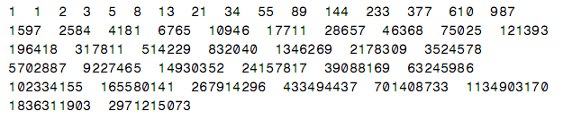
Operators Precedence
//Arithmetic and Relational Operators
//demonstrates while loops using Fibonacci series
#include<iostream.h>
#include<conio.h>
void main()
{ clrscr();
const unsigned long limit=4294967295;
unsigned long next=0;
unsigned long last=1;
while (next < limit/2)
{
cout<<last<<" ";
long sum = next + last;
next=last;
last=sum;
}
cout<<endl;
getch();
}

Slide 128
Example of while Loop
// chcount.cpp
// counts characters and words typed in
#include <iostream.h>
#include <conio.h> // for getche()
void main()
{
int chcount=0; //counts non-space characters
int wdcount=1; // space between two words
char ch=‘a’;
cout<<“Enter a phrase:”;
while(ch != ‘\r’ ) // loop until Enter typed
{
ch=getche(); //read one character
if(ch==‘ ‘ ) // if it’s a space
wdcount++; // count a word
else // otherwise,
chcount++; // count a character
} // display results
cout << “\nWords=” << wdcount << endl << “Letters=” <<(chcount-1) << endl;
}

Slide 129
Example of while Loop
// chcnt2.cpp
// counts characters and words typed in
#include <iostream.h>
#include <conio.h> // for getche()
void main()
{
int chcount=0;
int wdcount=1; // space between two words
char ch;
cout<<“Enter a phrase”;
while( (ch=getche()) != ‘\r’ ) // loop until Enter typed
{
if( ch==’ ‘ ) // if it’s a space
wdcount++; // count a word
else // otherwise,
chcount++; // count a character
} // display results
cout << “\nWords=” << wdcount << endl << “Letters=” << chcount << endl;
}

Slide 130
Example of while Loop
// advenand.cpp
// demonstrates AND logical operator
#include <iostream.h>
#include <process.h>
#include <conio.h>
void main()
{
char dir=’a’;
int x=10, y=10;
while( dir != ‘\r’ )
{
cout << “\nYour location is “ << x << “, “ << y;
cout << “\nEnter direction (n, s, e, w): “;
dir = getche(); //get direction (or) cin>>dir;
switch(dir)
{
case ‘n’: y++; break; //update coordinates
case ‘s’: y--; break;
case ‘e’: x++; break;
case ‘w’: x--; break;
}
if( x==7 && y==11 ) //if x is 7 and y is 11
{
cout << “\nYou found the treasure!\n”;
exit(0); //exit from program
}
} //end while
}

Slide 131
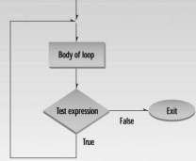
The do loop
If you don’t know how many times
The text_expression is placed at the end of the loop
The loop body is executed at least once
Syntax:
do
statement;
while(test_expression);
(or)
do {
statement_1; … statement_n;
}while(test_expression);
no semicolon here
semicolon

Slide 132
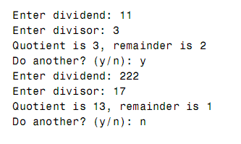
do loop - Example
//divdo.cpp
//demonstrates do loop
#include<iostream.h>
#include<conio.h>
void main()
{
clrscr();
long dividend, divisor;
char ch;
do {
cout<<"Enter dividend: ";cin>>dividend;
cout<<"Enter divisor: ";cin>>divisor;
cout<<"Quotient is "<<dividend/divisor;
cout<<", remainder is "<<dividend % divisor;
cout<<"\nDo another? (y/n): ";
cin>>ch;
}while(ch !='n');
getch();
}

Slide 133
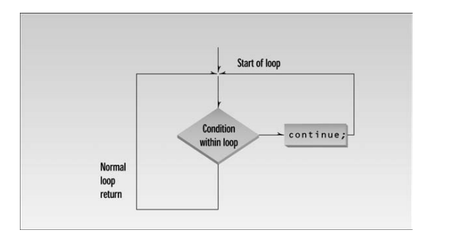
The continue Statement
// divdo2.cpp
// demonstrates CONTINUE statement
#include <iostream.h>
void main()
{
long dividend, divisor;
char ch;
do {
cout << “Enter dividend: “;
cin >> dividend;
cout << “Enter divisor: “;
cin >> divisor;
if( divisor == 0 ) //if attempt to
{ //divide by 0,
cout << “Illegal divisor\n”; //display message
continue; //go to top of loop
}
cout << “Quotient is “ << dividend / divisor;
cout << “, remainder is “ << dividend % divisor;
cout << “\nDo another? (y/n): “;
cin >> ch;
} while( ch != ‘n’ );
}

Slide 134
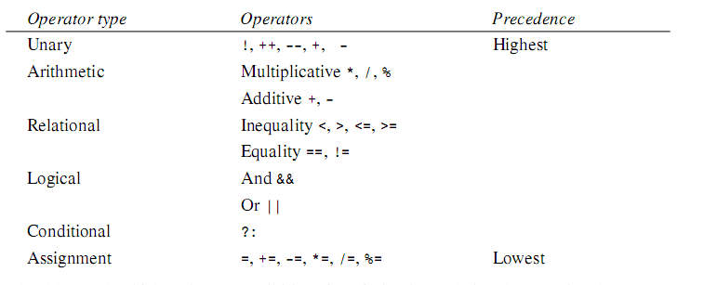
Precedence Summary

Slide 135
getch() : This function is used to accept single character from user, but it has no echo (display) on screen when it is pressed. Mostly it is used at the end of program, when user need to see final output of the program.
getche() : This function is used to accept single character from user, and it has echo (display) on screen when it is pressed.

Slide 136
Exercises
Write a C++ program that calculates 1+2+3+…+99+100.
Write a C++ program that calculates 100+99+98+…+2+1.
Write a C++ program that calculates 1+3+5…+97+99.
Write a C++ program that calculates 2+4+6+…+98+100.
Write a C++ program that calculates 1²+2²+3²+…+n².
Write a C++ program that accept the integer numbers until input number is 0and find the sum of odd numbers. Then display the prime numbers among them.

Slide 137
Lets Do Exercises!!!

Slide 138
CHAPTER-7 ARRAYS AND STRINGS

Slide 139
Defining Arrays
In computer languages also need to group together data items of the same type.
The most basic mechanism that accomplishes in C++ is the array.
Arrays can hold a few data items or tens of thousands.
The data items grouped in an array can be simple types such as int or float or user -defined types such as structures and objects.
An array must be defined before it can be used to stored information.
An array definition specifies a variable type, a name and another feature : a size.
The size specifies how many data items the array will contain.
It immediately follows the name, and is surrounded by square brackets.

Slide 140
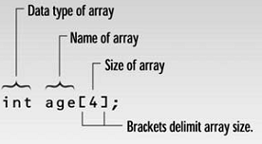
Array Syntax

Slide 141
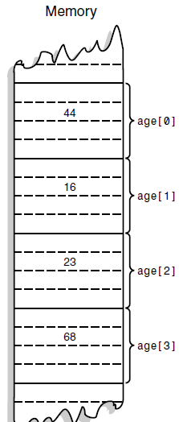
Array Elements and accessing array elements
The items in an array are called elements
All the elements in an array are of the same type ; only the values vary
The first array element is numbered 0.
Thus, since there are four elements, the last one is number 3.
age[0] refers to the first element, age[1] refers to the second element , and so on.
The variable(or constant )in the brackets is called the array index.

Slide 142
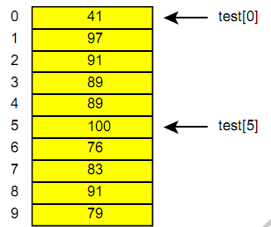
Array Fundamentals
One-dimensional Array
Example:
int test[10]; // space for 10 ints

Slide 143
Array Example
//replay.cpp
#include< iostream.h >
#include< conio.h >
void main()
{
int age[4];
for(int j=0;j<4;j++)
{
cout<<"Enter an age:";
cin>>age[j];
}
for(j=0;j<4;j++)
cout<<"You entered "<<age[j]<<endl;
getch();
}

Slide 144
Averaging Array Elements Example
//sales.cpp
#include<iostream.h>
#include<conio.h>
void main()
{ const int SIZE=6;
double sales[SIZE];
cout <<"Enter widget sales for 6 days\n";
for(int j=0;j<SIZE ;j++)
cin >>sales[j];
double total=0;
for(j=0;j<SIZE ; j++)
total+=sales[j];
double average=total/SIZE;
cout <<"Average="<<average<< endl;
getch();
}

Slide 145
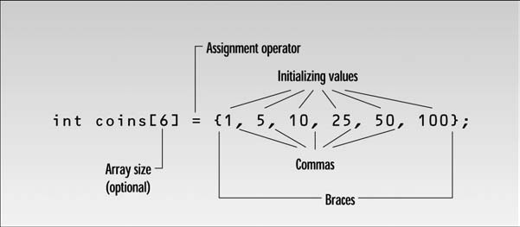
Initializing Arrays
Example
int days_per_month[12]={31,28,31,30,31,30,31,31,30,31,30,31} ;
(or)
int days_per_month[] = {31,28,31,30,31,30,31,31,30,31,30,31};
Syntax of array initialization

Slide 146
Initializing Arrays Example
//days.cpp
#include<iostream.h >
#include<conio.h >
void main()
{ int month , day, total_days ;
int days _per_ month[12]={31, 28, 31, 30, 31, 30, 31, 31, 30, 31, 30, 31};
cout<<"\nEnter month(1 to 12):";
cin>>month;
cout<<"Enter days(1 to 31):";
cin>>day;
total_days=day;
for(int j=0;j<month-1;j++)
total_days+=days_per_month[j];
cout<<"Totals days from start of year is :"<<total_days<<endl;
getch();
}

Slide 147
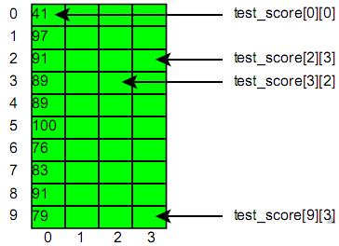
Two-dimensional Array
float test_score[10][4]; // space for 40 floats

Slide 148
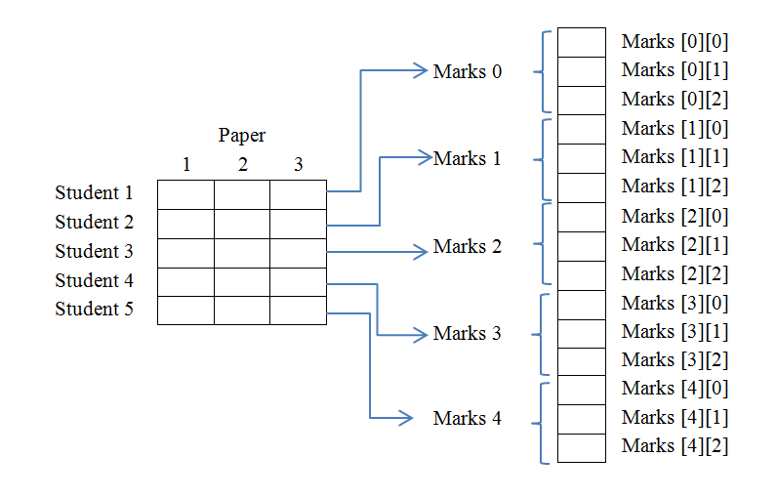
Two dimensional Array

Slide 149
Multidimensional Array Example
//stumarks.cpp
#include<iostream.h>
#include<conio.h>
#include<iomanip.h>
void main()
{ const int STUDENTS=5;
const int PAPERS=3;
int s,p;
int Marks[STUDENTS][PAPERS];
for(s=0;s<STUDENTS;s++)
for(p=0;p< PAPERS;p++)
{ cout<<"Enter marks for student "<<s+1;
cout<<" , paper "<<p+1<<" : “;
cin>>Marks[s][p];
}
cout<<endl<<endl;
cout<<" Paper\n";
cout<<" 1 2 3";
for(s=0;s<STUDENTS;s++)
{ cout<<"\nStudent "<<s+1;
for(p=0;p<PAPERS;p++)
cout<<setw(10)<<Marks[s][p];
}
cout<<endl;
getch();
}

Slide 150
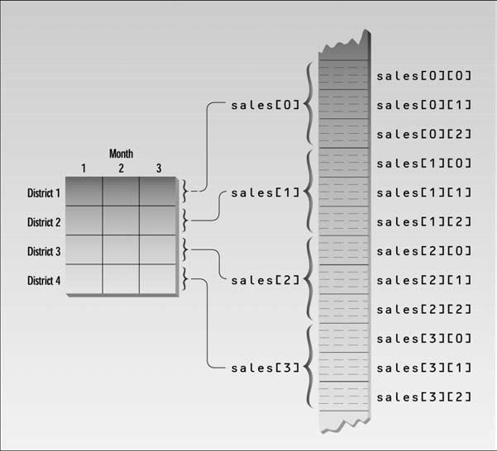
Two dimensional Array

Slide 151
Multidimensional Array Example
//salemon.cpp
//displays sales chart using 2-d array
#include<iostream.h>
#include<conio.h>
#include<iomanip.h>
void main()
{ const int DISTRICTS=4;
const int MONTHS=3;
int d,m;
double sales[DISTRICTS][MONTHS];
for(d=0;d<DISTRICTS;d++)
for(m=0;m<MONTHS;m++)
{ cout<<"Enter sales for district "<<d+1;
cout<<" , month "<<m+1<<" : “; cin>>sales[d][m];
}
cout<<endl<<endl;
cout<<" Month\n";
cout<<" 1 2 3";
for(d=0;d<DISTRICTS;d++)
{ cout<<"\nDistrict "<<d+1;
for(m=0;m<MONTHS;m++)
cout<<setprecision(2)<<setw(10)<<sales[d][m];
}
cout<<endl;
getch();
}

Slide 152
Initializing Multidimensional Array
#include<iostream.h>
#include<conio.h>
#include<iomanip.h>
const int DISTRICTS=4;
const int MONTHS=3;
void main()
{
clrscr ();
int d , m;
double sales[DISTRICTS][MONTHS]={ {1432.07,234.50,654.01},
{322.00,13838.32,17589.88},
{9328.34, 934.00, 4492.30},
{12838.29, 2332.63,32.93}
};

Slide 153
Initializing Multidimensional Array (Continued)
cout<<"\n\n";
cout<<" Month\n";
cout<<" 1 2 3 ";
for(d=0;d<DISTRICTS;d++)
{
cout<<"\nDISTRICTS "<<d+1;
for(m=0;m<MONTHS;m++)
cout<<setiosflags(ios::fixed)<<setiosflags(ios::showpoint)
<<setprecision(2)<<setw(10)<<sales[d][m];
}
cout<<endl;
getch();
}

Slide 154
Sorting an Array
Exchange Sort
Bubble Sort
Counting Sort
Selection Sort
Insertion Sort
Merge Sort
Quick Sort
Radix Sort
…
// Ascending Order by Exchange Sort
int data[5]={20,45,10,5,35};
int temp;
for(int i=0;i<5;i++)
for(int j=0;j<i;j++)
{
if(data[i]<data[j])
{
temp=data[i];
data[i]=data[j];
data[j]=temp;
}
}

Slide 155
Exchange Sorting
#include<iostream.h>
#include<conio.h>
void main()
{
clrscr();
const int max=100;
int A[max],i,j,n,temp;
//array input
cout<<"How many number";
cin>>n;
for(i=0;i<n;i++)
{
cout<<"Enter a number: ";
cin>>A[i];
}
// Ascending Order by Exchange Sort
for(i=0;i<n;i++)
{
for(j=0;j<i;j++)
{
if(A[i]<A[j])
{
temp=A[i];
A[i]=A[j];
A[j]=temp;
}
}
}
//Sorting order output
cout<<"Sorted Number ";
for(i=0;i<n;i++)
cout<<A[i]<<" ";
getch();
}

Slide 156
Searching
Consider searching for a given value v in an array of size N. There are 2 basic approaches:
Sequential Search / Linear Search
Binary Search (preliminary→ must be sorted array)
//Linear search
int data[5]={34,56,20,79,17};
int snum,flag=0;
cout<<"Enter searched number";cin>>snum;
/* for(int i=0;i<5;i++) {
if(data[i]==snum) {
flag=1; break;
}
} */
int i=0;
while(i<5 && !flag) {
if(data[i]==snum) flag=1;
i++;
}
if(flag) cout<<"Found";
else cout<<"Not Found";
//Binary Search
int data[5]={20,35,47,90,2};
int first=0,last=4,mid,snum,flag=0;
cout<<"Enter searched number";cin>>snum;
while(first<=last && !flag)
{
mid=(first+last)/2;
if(snum<data[mid])
last=mid-1;
else if(snum>data[mid])
first=mid+1;
else flag=1;
}
if(flag) cout<<"Found";
else cout<<"Not Found";

Slide 157
String (or) C-String
C-String are array of type char
Declarations
char str[30];
char *str;
Input a string from standard input
cin>>str; (or)
const int MAX=80; cin.get(str,MAX); (or)
cin.get (str,MAX,’$’); (or)
gets(str); // needs <stdio.h> header file
String Constants
char str[] = “This is a test”;
char str[] = {‘T’, ‘h’, ‘i’, ‘s’, ‘ ’, ‘i’, ‘s’, ‘ ’, ‘a’, ‘ ’, ‘t’, ‘e’, ‘s’, ‘t’};

Slide 158
String (or) C-String
//C-String Variable
#include<iostream.h>
#include<conio.h>
void main()
{
clrscr();
const int max=20;
char str[max];
cout<<“Enter a String: ”;
cin>>str;
cout<<“You Entered: “<<str;
getch();
}
//Avoiding Buffer Overflow
#include<iostream.h>
#include<conio.h>
#include<iomanip.h>
void main()
{
clrscr();
const int max=20;
char str[max];
cout<<“Enter a String: ”;
cin>>setw(max)>>str;
cout<<“You Entered: “<<str;
getch();
}

Slide 159
String (or) C-String
//Reading Embedded Blanks
//To read text containing blanks, use cin.get()
#include<iostream.h>
#include<conio.h>
void main()
{
clrscr();
const int max=20;
char str[max];
cout<<“Enter a String: ”;
cin.get(str,max);
cout<<“You Entered: “<<str;
getch();
}
//Reading Multiple Lines
//Read multiple lines, terminates an ‘$’ character
#include<iostream.h>
#include<conio.h>
void main()
{
clrscr();
const int max=100;
char str[max];
cout<<“Enter a String: ”;
cin.get(str,max,’$’);
cout<<“You Entered: “<<str;
getch();
}

Slide 160
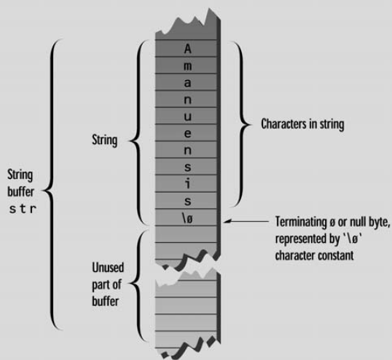
String stored in string variable
String must terminate with a byte containing 0 which is represented by the character constant ‘\0’ or null character

Slide 161
Built-in Function for string operations
Study built-in function for string operation in Help
strlen
strcpy
strchr, strstr
strcmp, stricmp, strcmpi
strcat
NOTE-declare the header file <string.h> for these function

Slide 162
Copying a string the Hard Way
//Copying a String the Hard Way
//cpystr.cpp
#include<iostream.h>
#include<string.h>
void main()
{ char str1[]="Oh, Captain, my captain! our fearful trip is done”;
const int MAX=80;
char str2[MAX];
for(int j=0;j<strlen(str1);j++)
str2[j]=str1[j];
str2[j]='\0';
cout<<str2<<endl;
getch();
}

Slide 163
Copying a string the Easy Way
//Copying a string the Easy Way
//cpystr2.cpp
#include<iostream.h>
#include<conio.h>
#include<string.h>
void main()
{ char str1[]="Tiger , tiger, burning bright\n:"
"In the forests of the night";
const int MAX=80;
char str2[MAX];
strcpy(str2,str1);
cout<<str2<<endl;
getch();
}

Slide 164
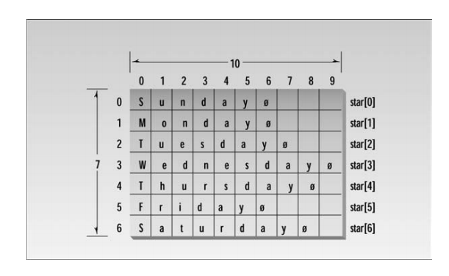
Array of String
//Page 297
// straray.cpp
#include<iostream.h >
#include< conio.h >
void main()
{
clrscr();
const int DAYS=7; //number of strings in array
const int MAX=10; // maximum size of each string
char star[DAYS][MAX]={"Sunday", "Monday","Tuesday",
"Wednesday“ , "Thursday", "Friday", "Saturday"};
for (int j=0;j<DAYS; j++)
cout <<star[j]<< endl;
getch();
}

Slide 166
Lets Do Exercises!!!

